Slide 1
Data Structures Algorithm and Design SSZG519
Mr. Chennupati R Prasanna

Slide 2
SSZG519-Asymptotic notation

Slide 3
Pseudocode
High-level description of an algorithm
More structured than English prose
Less detailed than a program
Preferred notation for describing algorithms
Hides program design issues
Example: find max element of an array
Algorithm arrayMax(A, n)
Input array A of n integers
Output maximum element of A
currentMax ← A[0]
for i ← 1 to n − 1 do
if A[i] > currentMax then
currentMax ← A[i]
return currentMax

Slide 4
Pseudocode Details
Control flow
if … then … [else …]
while … do …
repeat … until …
for … do …
Indentation replaces braces
Method declaration
Algorithm method (arg [, arg…])
Input …
Output …
Expressions
Assignment (like = in C / Java)
Equality testing (like == in C / Java)
n² Superscripts and other mathematical formatting allowed

Slide 5
Primitive Operations
Basic computations performed by an algorithm
Identifiable in pseudocode
Largely independent from the programming language
Exact definition not important (we will see why later)
Assumed to take a constant amount of time in the RAM model
Examples:
Assigning a value to a variable
Indexing into an array
Calling a method
Returning from a method

Slide 6
The Random Access Machine (RAM) Model (*)
A CPU
A potentially unbounded bank of memory cells, each of which can hold an arbitrary number or character
2
1
0
Memory cells are numbered and accessing any cell in memory takes unit time.

Slide 7
Counting Primitive Operations
By inspecting the pseudocode, we can determine the maximum number of primitive operations executed by an algorithm, as a function of the input size.
Algorithm arrayMax(A, n)
# operations
currentMax ← A[0] 2
for (i =1; i<n; i++) 2n
(i=1 once, i<n n times, i++ (n-1) times)
if A[i] > currentMax then 2(n − 1)
currentMax ← A[i] 2(n − 1)
return currentMax 1
Total 6n −1

Slide 8
Estimating Running Time
Algorithm arrayMax executes 6n − 1 primitive operations in the worst case.
Define:
a = Time taken by the fastest primitive operation
b = Time taken by the slowest primitive operation
Let T(n) be worst-case time of arrayMax. Then a (6n − 1) ≤ T(n) ≤ b(6n − 1)
Hence, the running time T(n) is bounded by two linear functions

Slide 9
Running Time
What is best, average, worst case running of a problem?
Average case time is often difficult to determine – why?
We focus on the worst case running time.
Easier to analyze and best to bet
Crucial to applications such as games, finance and robotics

Slide 10
Time Complexity- Why should we care?
Ram
Shyam
for i ←2 to n-1
If i divides n
n is not prime
-------------------------------------
I ms for a division in worst case (n-2) times.
n =11 ------?
n = 101 -------?
for i ← 2 to √n [ till the square root of n]
if i divides n
n is not prime
-------------------------------------
Worst case
(√n-1) times
(3-1) = 2ms
(√101-1) times = 9ms

Slide 11
How to analyze complexity?
Running time depends upon.
☐ single vs multi-processor
☐ read/ write speed to memory
☐ 32-bits vs 64-bits
☐input: rate of growth of time algorithm.
Model Machine[Hypotecial Model]
single processor
32- bits
sequential execution
1 unit time for assignment and return
1 unit time for arithmetical and logical operation

Slide 12
Example
To find the sum of two numbers
Sum(a+b)
{
Return a+b
}
T_{sum} = 2 { it’s a constant time algorithm)

Slide 13
Other example
To find the sum of integers
Sum of list(A,n)
{
Total = 0
For i=0 to n-1
Total = total +A;
Return total
}
T_{sum of list} = 1+2(n+1)+2n+1
= 4n+4
T(n) = cn+c’
Where c= c₂+c₃
c’ = c₁+c₂+c₄

Slide 14
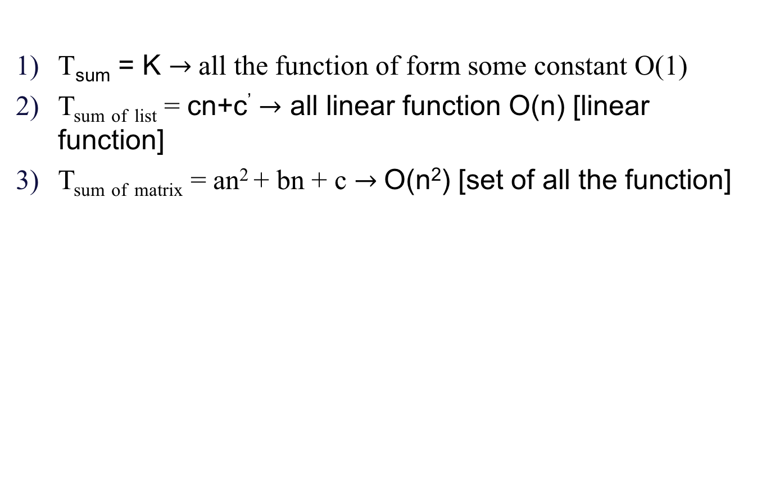
Example (Cont..,)
T_{sum of matrix}
Y
T_{sum of list}
T_{sum}
X (n-input size)

Slide 15
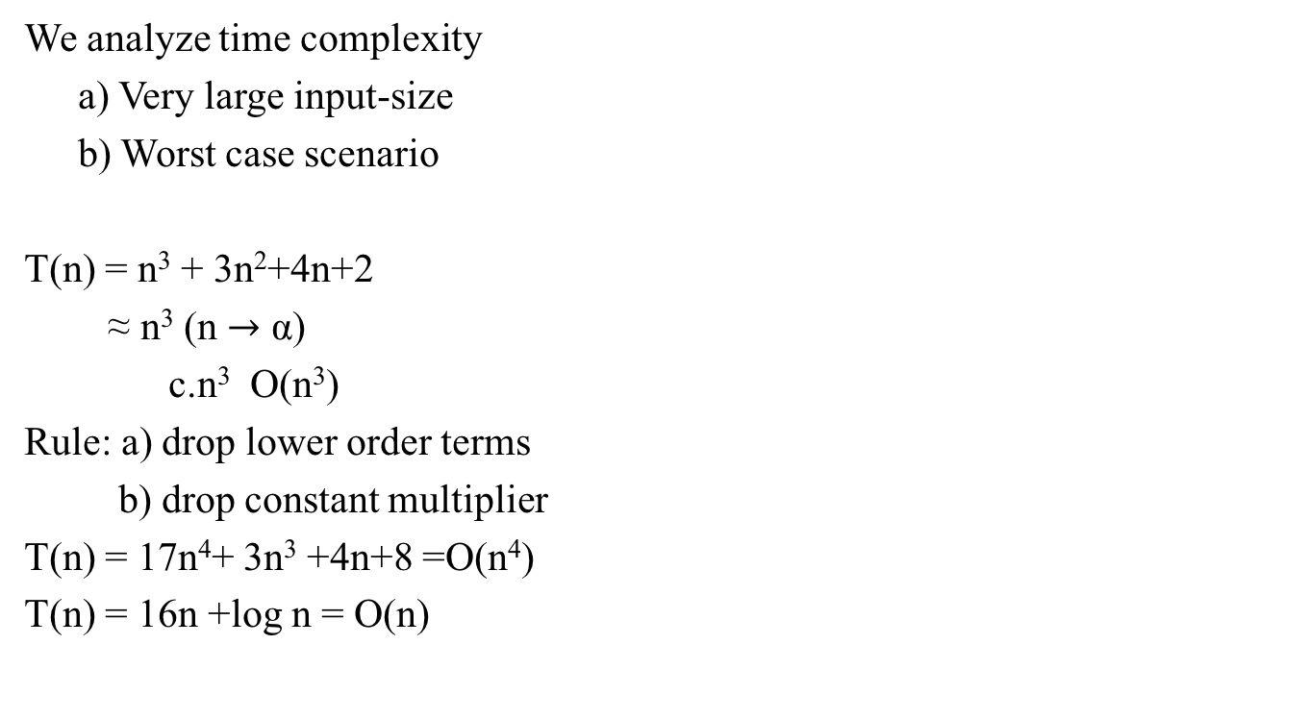
Time complexity analysis-some general rules.

Slide 16

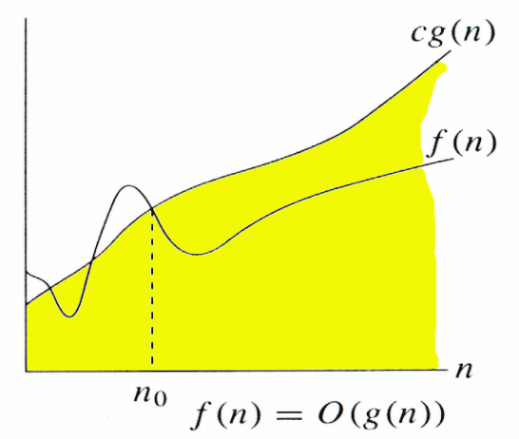

Big-Oh Notation
Given functions f(n) and g(n), we say that f(n) is O(g(n)) if there are positive constants c and n₀ such that
f(n) ≤ cg(n) for n ≥ n₀
For function g(n), we define O(g(n)), big-O of n, as the set:
O(g(n)) = {f(n) : ∃ positive constants c and n_{0,}
such that 0 ≤ f(n) ≤ cg(n) ∀n ≥ n₀ }
Example
O(n²) = {2n² + 10n + 2000, 125n² – 233n - 250, 10n + 25, 150, …..}
Notes:
Please find the explanation in lecture notes for slide no 16,17 and 18

Slide 17
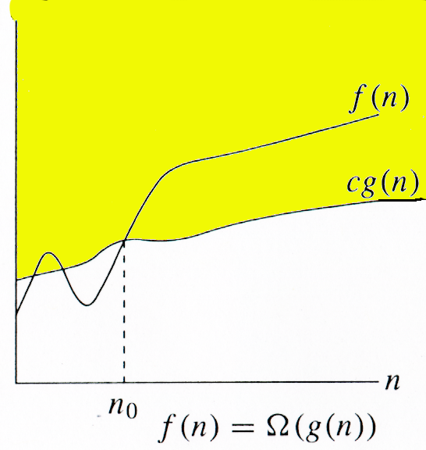
Relatives of Big-Oh (Ω(n) )
big-Omega
f(n) is Ω(g(n)) if there is a constant c > 0 and an integer constant n₀ ≥ 1 such that f(n) ≥ c•g(n) for n ≥ n₀
For function g(n), we define Ω(g(n)),
big-Omega of n, as the set:
Ω(g(n)) = {f(n) : ∃ positive constants c and n_{0,}
such that 0 ≤ cg(n) ≤ f(n) ∀n ≥ n0}

Slide 18
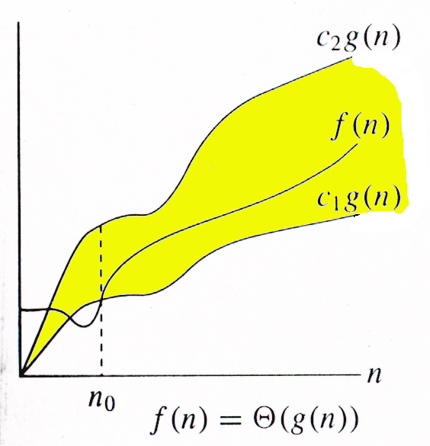
Relatives of Big-Oh (Θ(n))
big-Theta
f(n) is Θ(g(n)) if there are constants c’ > 0 and c’’ > 0 and an integer constant n₀ ≥ 1 such that c’•g(n) ≤ f(n) ≤ c’’•g(n) for n ≥ n₀
If f∈O(g) and g∈O(f), then we say
“g and f are of the same order” or
“f is (exactly) order g” and
write f∈Θ(g).
For function g(n), we define Θ(g(n)),
big-Theta of n, as the set:
Θ(g(n)) = {f(n) : ∃ positive constants c₁, c₂, and n_{0,} such that ∀n ≥ n₀,we have 0 ≤ c₁g(n) ≤ f(n) ≤ c₂g(n)}

Slide 19
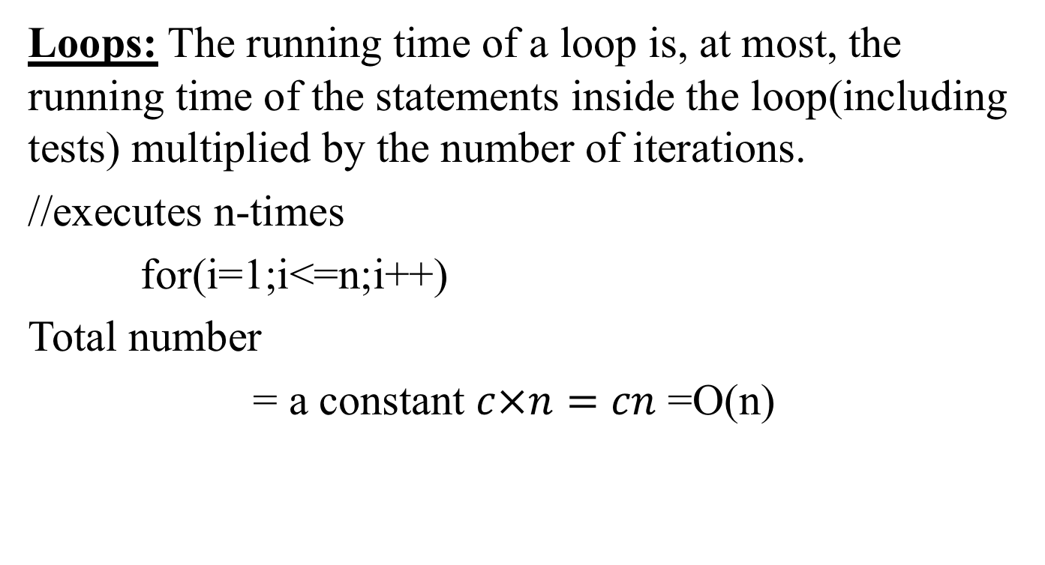
General rules to determine running time of algorithm
Loops: The running time of a loop is, at most, the running time of the statements inside the loop(including tests) multiplied by the number of iterations.
//executes n-times
for(i=1;i<=n;i++)
Total number
= a constant $c×n=cn$ =O(n)

Slide 20
Thank You!!

